Slide 1


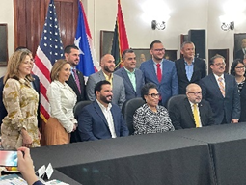
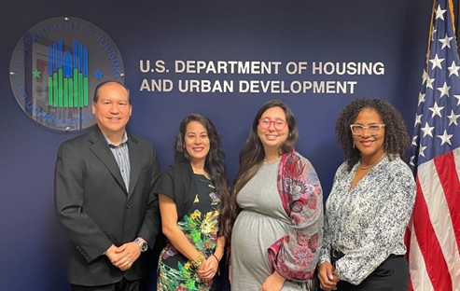
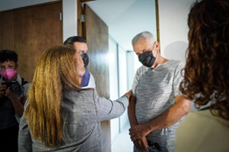
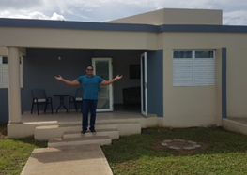
Customer Service and Referrals
U.S. DEPARTMENT OF HOUSING AND URBAN DEVELOPMENT
San Juan Field Office-Region IV
Charlene Rodriguez Gomez, Program Analyst
Office of Field Policy and Management
Charlene Rodriguez Gomez- Program Analyst
Sasha Davila- Program Analyst

Slide 2

Contact the HUD San Juan Field Office (PR & USVI)
Office Main Line: 787-766-5400
Fax: (787) 766-5995
TTY: (787) 274-5898
(If you're deaf or hard of hearing)
US Department of Housing and Urban Development
San Juan Field Office
235 Federico Costa Street, Suite 200
San Juan, Puerto Rico 00918
Office Hours: 8:00 a.m. to 4:30 p.m.
Monday through Friday
Email: pr_webmanager@hud.gov

Slide 3
HUD’s Lobby- Self Service
Tray to leave correspondence and packages. A secure Mailbox has been ordered.
Visitors with appointments can use office phone to communicate, phone directory
Mailboxes with fact sheets and information on HUD programs and frequently requested materials

Slide 4
Types of Inquiries
  General Questions- from the general public, program participants, grantees, non-profits, municipalities, realtors, lawyers, students, community groups, case workers, foster care, media, etc.
  Program Questions and Complaints- PIH, FHEO, CPD, MF, HH, SF, ODR…
How we receive Inquiries
  In person, self-service mailbox, by phone, fax, email, regular mail, referrals, Corresponding Tracking System (CTS), FOIA, or any other means.

Slide 5
Escalations by program – Program Offices provide 10 to 15 days for the PHA or Grantee to formally respond
PIH (HCV, PH, VASH) – Refer to the grantee; if no resolution, escalate to HUD supervisor to assign.
MF – Refer to PBCA (AFV), escalate to HUD Director if necessary.
CPD – Refer to the grantee, escalate to SanJuanCPDCorrespondence@hud.gov.
ODR - Refer to grantee, escalate to DisasterRecovery@hud.gov.
FHEO – Provide discrimination complaint form and escalate to intake branch.
SF- Refer to the lender or servicing, escalate to the Atlanta Homeownership Center or supervisor.

Slide 6
Information needed for a complaint
Complainant’s Full Name
Address
Phone
Email
Case or voucher number
Grantee or PHA
Description of the facts- Pertinent to the complaint
Administrative actions initiated by the complaint
Program Manager information
Supporting documents, if any
Petition to HUD

Slide 7
Contact Information for Field Office Supervisors by Program Area
Single Family: Lavelanet, Rachel A Rachel.A.Lavelanet@hud.gov
Multifamily: Daniel M. Ortiz Daniel.M.Ortiz@hud.gov
Public Housing: Aponte, Amabelle Amabelle.Aponte@hud.gov and/or Negron, Nilsa E Nilsa.E.Negron@hud.gov
CPD: Ortiz, Wilfrido G Wilfrido.G.Ortiz@hud.gov
Disaster Recovery: Rivera-Carrion, Laura I Laura.I.Rivera-Carrion@hud.gov
FHEO: Berrios, Luis O Luis.O.Berrios@hud.gov

Slide 8


U.S. Department of Housing and Urban Development
Community Planning and Development
Community Development Block Grant Disaster Recovery
Office of Disaster Recovery
Complaints and Inquiries Process Overview
May 2023

Slide 9

What is a complaint?
A complaint is a written statement received from the public that alleges a violation of a federal rule, law or regulation or state regulation. The Office of Disaster Recovery (ODR) has established guidelines and processes for handling complaints.

Slide 10
What is an inquiry?
An inquiry is also received from the public in the same way complaints are, however, they do not allege programmatic or regulatory violations. Often, it’s a beneficiary or another public stakeholder asking a general question about a CDBG-DR funded program.

Slide 11
Types of Complaints and Inquiries
There are a variety of complaint and inquiry types submitted. Below is a list of most common types. Please note, this is not an exhaustive list:
  • General Complaints (“complaints”)
  • Community Group Complaints
  • Inquiries
  • Community Inquiries on Programs
  • Congressional Complaints (self or constituent)
  • Congressional Inquires
  • OIG Referrals

Slide 12
Process
All complaints must be sent to the disaster_recovery@HUD.gov mailbox
If the complaint is received by phone, the staff person encourages the complainant to submit their complaints, in writing, to the disaster_recovery@HUD.gov mailbox.
Or, ask the complainant for certain information and submits the complaint on their behalf to the disaster_recovery mailbox.

Slide 13
Timeframe for Response
  As written in CPD’s Complaints Handbook, HUD must forward complaints to the grantee within ten (10) calendar days of receipt. The grantee must respond in writing to the complainant within fifteen (15) calendar days after receipt of the compliant. ODR may extend the grantee’s timeframe to respond up to thirty (30) days, if needed.
  https://www.hud.gov/sites/documents/55520CPDH.PDF
  2018-02693.pdf (govinfo.gov)

Slide 14
Requesting Grantee Response
As stated, within 10 days of the receipt of the complaint, the Grant Manager must send a formal request to the grantee to respond to the complaint. At this step the Grant Manager communicates the following:
    Advise the grantee of its responsibility to respond to the complainant, the 15-day response timeframe, and the requirement to send a copy of the response to the Disaster Recovery mailbox and assigned Grant Manager.
The grantee its responsible to respond to the complainant, the 15-day response timeframe, and the requirement to send a copy of the response to the Disaster Recovery mailbox and assigned Grant Manager.

Slide 15
Evaluating the Grantee’s Response & Potential Courses of Action
The following is suggested guidance. Not all complaints will require the following steps. The Grant Manager can take the following steps when evaluating a complaint and the grantees’ response for potential grantee deficiencies:
  Review ODR’s correspondence log
  Review the Grantee’s response and compare it to regulatory and programmatic requirements, as established in applicable Federal Notices, 24 CFR 570, or cross-cutting requirements.
  A review of the grantee’s performance reporting can be conducted.
  If the Grantee’s response alludes to potential deficiencies, the Grant Manager may request the grantee to respond further to the specific concern.

Slide 16
Evaluating the Grantee’s Response & Potential Courses of Action
If the grantee’s follow up response doesn’t resolve the potential deficiency, the following options are available to the Grant Manager to remedy the deficiency:
  Provide technical assistance
  Include special attention to the topic during the next scheduled monitoring visit
  Conduct desk monitoring to evaluate the potential deficiency
  Schedule an additional monitoring visit to evaluate the potential deficiency.
If any of the above courses of action are taken, ODR’s focus should be to resolve the programmatic or administrative deficiency, not to directly resolve the complaint.

Slide 17
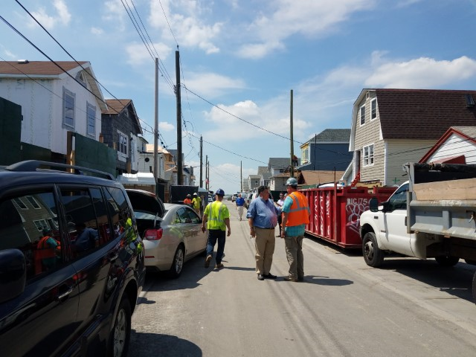
Referrals to OIG

Slide 18
Escalating Claims of Fraud to the OIG
If a complaint alleges fraud, waste, or abuse of HUD funds, the Grant Manager must refer it to the Assistant Inspector General for Investigation within the Office of Inspector General using the email hotline@hudoig.gov, copying the disaster_recovery@HUD.gov mailbox.
The following are a few examples of fraud, waste, and abuse:
  • Abuse of authority or conflict of interests
  • Housing subsidy fraud
  • Serious mismanagement
  • Ethics violations by HUD officials
  • Bribery
This is not an exhaustive list. For more information on the type of fraud claims that should be referred to the OIG’s Fraud hotline, please visit: https://www.hudoig.gov/hotline/report-fraud

Slide 19

Referrals to FHEO

Slide 20
Referring Civil Rights Violations to FHEO
As defined in the CPD Complaints Handbook, Civil Rights complaints are:
“Civil rights complaints are those alleging violation of one or more of the following statutes: Title VI of the Civil
Rights Act of 1964, Section 109 of the Housing and Community Development Act of 1974, Section 504 of the
Rehabilitation Act of 1973, the Age Discrimination Act of 1975, Section 3 of the Housing and Urban
Development Act of 1968, and Executive Orders 11063 and 11246.”

Slide 21
Referring Civil Rights Violations to FHEO
Potential Civil Rights violations must be referred to the Office of Fair Housing and Equal Opportunity for investigation (FHEO) by speaking with an FHEO intake specialist by calling 1-800-669-9777 or 1-800-877-8339 or submitting the complaint online at: https://www.hud.gov/program_offices/fair_housing_equal_opp/onlinecomplaint
To obtain your regional FHEO Office’s contract information please refer to the following page: https://www.hud.gov/program_offices/fair_housing_equal_opp/contact_fheo#c4

Slide 22
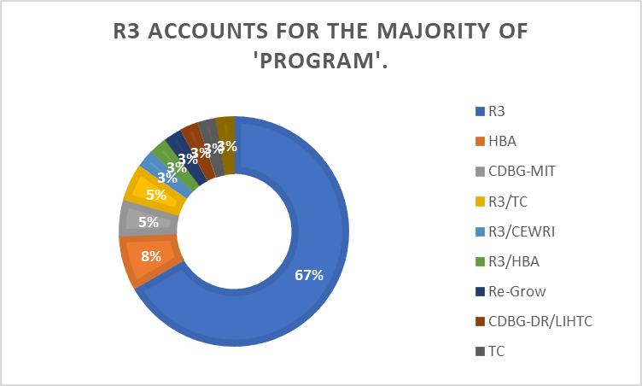
Data from complaints submitted to ODR

Slide 23
Data from complaints submitted to ODR

Slide 24
Data from complaints submitted to ODR

Slide 25

Questions

Slide 26
Thank you!!

